Slide 1
Understanding Bias in HateSpeech
STCI@ Microsoft, India IREL@ IIIT Hyderabad

Slide 2
Agenda
What is bias in the context of hate speech?
Source of bias
Societal Impact of biased predictions
Mitigating biases in learning
Challenges and Limitations

Slide 3
Definition
Bias is an error from erroneous assumptions in the learning algorithm.
Could be due to errors in the learning algorithm or the data.
Stereotypical Bias (SB): In social psychology, a stereotype is an over-generalized belief about a particular category of people.
In the context of hate speech, we define SB as an over-generalized belief about a word being Hateful or Neutral.
For Example – attributing the word muslim to hate/violence
Stereotypical Bias can be based on typical perspectives like skin tone, gender, race, demography, disability, Arab-Muslim background, etc.
It can be a complicated combinations of these as well as other confounding factors

Slide 4
Why does a model learn these biases?
Training from data
Using datasets
Ex. Twitter, Facebook, Reddit, Washington Post Comments, etc
Conversations on the Internet
All conversations are biased, so any model we learn will pickup that bias
Annotation Quality Check can be used to control the bias in training dataset, but its impossible to remove it completely, especially when training at scale.
How to Learn an unbiased model from biased conversations ?

Slide 5
Impact of biased predictions
Biased prediction systems → Low-quality unfair results for victim communities.
This unfairness can propagate into government/organizational policy making
Examples | Predicted Hate Label (Score)
Those guys are nerds | Hateful (0.83)
Can you throw that garbage please | Hateful (0.74)
People will die if they kill Obamacare | Hateful (0.78)
Oh shit. I did that mistake again | Hateful (0.91)
that arab killed the plants | Hateful (0.87)
I support gay marriage. I believe they have a might to be as miserable as the rest of us. | Hateful (0.77)
Examples of Incorrect predictions from
Google’s Perspective API (as on 15th Aug 2018)
Notes:
Since many of such prediction systems are critical in real-life decision making, this unfairness can propagate into government/organizational policy making and general societal perceptions about members of the victim communities

Slide 6
Mitigating Bias in Learning
Goal:
✔ Model is fair towards all the ethnic groups, minorities and gender
✔ Bias from social media is not learnt

Slide 7
Choices for Bias Mitigation
Statistical Correction: Includes techniques that attempt to uniformly distribute the samples of every kind in all the target classes, altering the train set with samples to balance the term usage across the classes.
Example: Strategic Sampling, Data Augmentation
Ex. This is a hateful sentence for muslim
Ex. This is a hateful sentence for muslim → +ve
Ex. This is NOT a hateful sentence for muslim → -ve
Limitations: Not always possible to create balanced samples for all the keywords

Slide 8
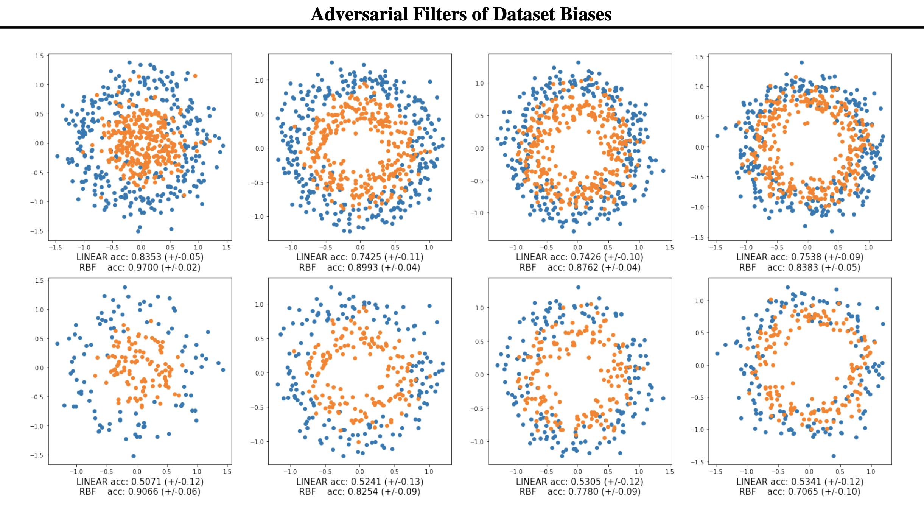
Choices for Bias Mitigation
Statistical Correction:
Example: Adversarial Filters of Dataset Biases (Bras et al. (2020), ICML 2020)
An iterative greedy algorithm that can adversarially filter the biases from the training dataset
De-biased Version
of Dataset

Slide 9
Choices for Bias Mitigation
Model Correction: Make changes to the model like modifying word embeddings or debiasing during model training
Example: Ensemble Learning
Model 1
Black-box
models
Model 2
Ensemble of black-box Models
Model 3

Slide 10

Choices for Bias Mitigation
Model Correction: Make changes to the model like modifying word embeddings or debiasing during model training
Example: Adversarial Learning (Xia et al. (2020))
Limitations: Need labels for all the private attributes that we want to correct
Model learns to identify hatespeech and gender
but NOT the gender
Input
Sentence
Model
Hateful ?
GRL
Private Attributes
Gradient Reversal Layer
Ex. Gender

Slide 11
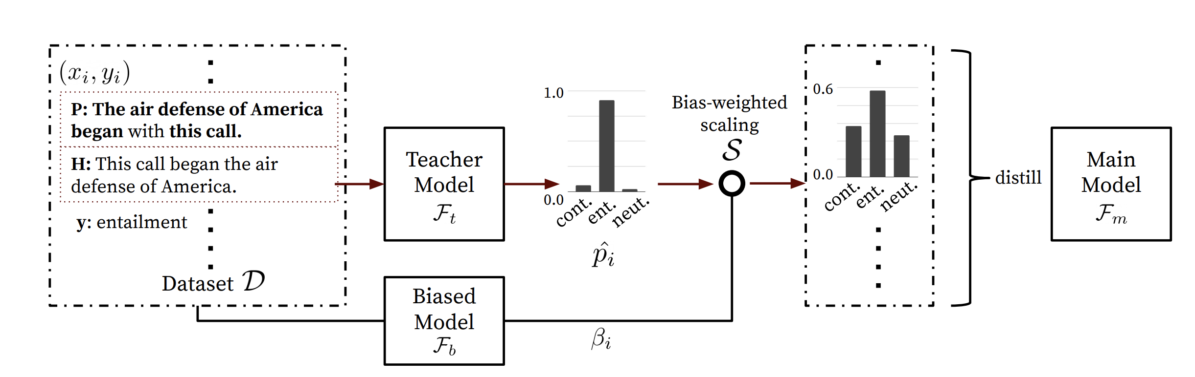
Choices for Bias Mitigation
Model Correction:
Example: Statistical Model re-weighing (Utama et al. (2020))
An input example that contains lexical-overlap bias is predicted as entailment by the teacher model with a high confidence. When biased model predicts this example well, the output distribution of the teacher will be re-scaled to indicate higher uncertainty (lower confidence). The re-scaled output distributions are then used to distill the main model

Slide 12
Choices for Bias Mitigation
Data Correction: Focuses on converting the samples to a simpler form by reducing the amount of information available to the classifier during learning-stage.
Example: Private-attribute masking, Knowledge generalization (Badjatiya et al., 2019)
Ex. This is a hateful sentence for muslim
Ex. This is a hateful sentence for ########
→ Can we do better?

Slide 13
Choices for Bias Mitigation
Replacing with Part-of-speech (POS) tags
Example: Muhammad set the example for his followers, and his example shows him to be a cold-blooded murderer.
Replace the word ‘Muhammad’ with POS tag ‘<NOUN>’
Replacing with Named-entity (NE) tags
Example: Mohan is a rock star of Hollywood
Replace the entities with tags <PERSON> and <ORGANIZATION> respectively
Replacing with WordNet generalizations (Badjatiya et al., 2019)

Slide 14
Knowledge-based Generalizations
WordNet Hierarchy

Slide 15
Challenges and Limitations
Problem still not solved, bias is prominent in almost all the learning algorithms
Nearly impossible to mitigate all the biases
Need automated mitigation techniques that work at scale, as biases could be based on unknown attributes

